Slide 1
BGASS ENTERPRISES PVT.LTD.
.

Slide 2
INTRODUCTION
Bgass Enterprises Private Limited are one of the famous Service Provider of a wide array of Data Entry Project, Online Data Entry Service, Data Entry Works, Offline Data Entry Service, Outsourcing Service, Form Filling Service, Non Voice BPO Service, Data Processing Service, Document Digitization Services, etc. Moreover, we are giving out these services under the capable direction of our professionals whom we have hired at our premises. Beside this, we carry stringent and rigorous check over the quality of these products before delivering them to our individual customer end. So as to become one of the favored business names, we rigorously focus towards furnishing the changing demands and requisites of our customers. For this purposes, we have chosen with us a skilled workforce that enables us to present our services on time with utmost accuracy. Selected after rounds of interview, we assure that all our employees possess the client-focused immense level of market understanding and knowledge of this domain. Handling this team is our guide, Mr. SOURAV SHARMA and Mr. GAURAV SHARMA, under whose leadership and support all our business tasks are completed effectively without any client-focused approach has also helped us in taking our enterprise towards newer pinnacles of success.

Slide 3
1. LEGAL NAME | BGASS ENTERPRISES PRIVATE LIMITED
2. TRADE NAME ,IF ANY | BGASS ENTERPRISES PRIVATE LIMITED
3. CONSTITUTION OF BUSINESS | PRIVATE LIMITED COMPANY
4. ADDRESS OF PRINCIPAL PLACE OF BUSINESS | E-113 FIRST FLOOR SECTOR 6 NOIDA UTTARPRADESH 201301
5. GSTIN | 09AAHCB1625J1ZO
6. CORPORATE IDENTITY NUMBER | U74999DL2017PTC315405
7. PERMENANT ACCOUNT NUMBER | AAHCBI625J

Slide 4
KINDS OF PROJECT WE DEAL WITH
ONLINE DATA ENTRY PROJECT
OFFLINE DATA ENTRY PROJECT

Slide 5
ONLINE DATA ENTRY PROJECT
A
COPY PASTE PROJECT
B
COPY PASTE DESCRIPTION

Slide 6
ONLINE COPY PASTE PROJECT
WORK DESCRIPTI
1. ONLINE DATA MINING PROJECT
2. TOTAL 12 FIELDS
3. THREE FIELD COPY PASTE REST
FIELDS DROP DOWN (YES/NO)
4. UNLIMITED DATA
5. NO FIXED TARGET
6. NO TIME LIMIT (24*6 WORKING)
7. FORM RATE 17 Rs. PER FORM
(INCREASES UPTO Rs.27)
8. TRAINING PROVIDED BY COMPANIES
SIDE
9. WORK TRACKING LINK PROVIDED
10. DAILY BASIS QUALITY CHECK REPORT
GENERATED
11. NO TERMINATION CLAUSE
WORK DESCRIPTION

Slide 7
BILLING CYCLE
BILLING GENERATED IN 7-7 DAYS
AFTER 7 DAYS YOU NEED TO GENERATE AN INVOICE
AFTER RECEIVING AN INVOICE PAYMENT WILL BE GENERATED IN 48 TO 72 HOURS

Slide 8
SECURITY AND SERVICE CHARGES
5 SEATS COST Rs.142500/- +18% GST(per seat Rs.28,500)
REQUIRED MINIMUM 5 SEATS
AMOUNT IS REFUNDABLE AFTER ELEVEN MONTHS
11 MONTHS LEGAL AGREEMENT WILL BE DONE ON STAMP PAPER WITH ALL VALID DOCUMENTS
- LC/BANK GUARANTEE,PDC ONLY PROVIDED FOR 10 PC

Slide 9
SERVICES
- EXTRA SOFTWARE FOR DATA TRACKING RECORDS
- ONLINE TRAINING
COMPLETE TECHNICAL SUPPORT
PROVIDE HIRING SUPPORT ALSO
NET CONNECTIVITY IS REQUIRED.SOFTWARE,SERVICES,ONSITE TRAINING AND SERVER PROVIDED FROM OUR SIDE.AGREEMENT IS DONE BY THE COMPANY’S SIDE AND WILL BE GENERATED ON STAMP PAPER,A LEGAL AGREEMENT,AMOUNT WILL BE NON REFUNDABLE AND NEGOTIABLE.
NOTE

Slide 10
OUR SOCIAL LINK
https://www.youtube.com/watch?v=G5MhsYzTJFo
http://www.bgasscompany.com/

Slide 11
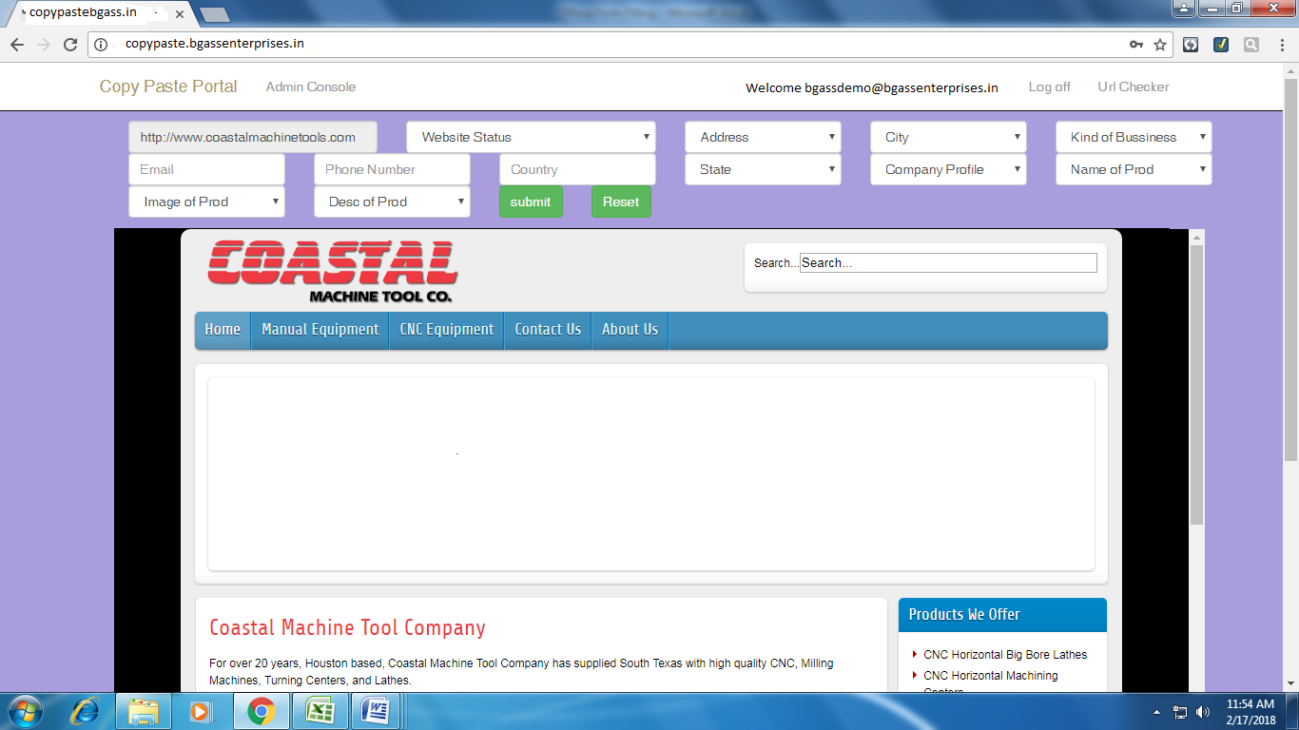
SAMPLE OF COPY PASTE PROJECT

Slide 12
DEMO AGREEMENT OF COPY PASTE PROJECT

Slide 13
ONLINE COPY PASTE DESCRIPTION
Nature of job | Copy Paste Description for portal
Work type | Copy - Paste
Software | User ID provided by company
Eligibility | Individual or Company
Duration | 11 months contract period
Work Flow | No fixed target/ Data provided by company
Minimum no. of seat | Five seat

Slide 14
Rate per Form | 12.00 INR. per form
No of Fields | 18 Fields
Data Transfer | Monthly basis
Billing Cycle | 15 Working days
Signup | Online with Indian End-Client
Training | Provided
Upfront Charges | INR 40,000/-(1 time charge)

Slide 15
PAYMENT SECURITY
POST DATED CHEQUE
11 MONTH LEGAL
AGREEMENT
- BANK GUARANTEE/LETTER OF CREDIT
SERVICES
-Extra software’s for data tracking
-Technical Support
-Provide Hiring records
-Online training
-Complete support also

Slide 16
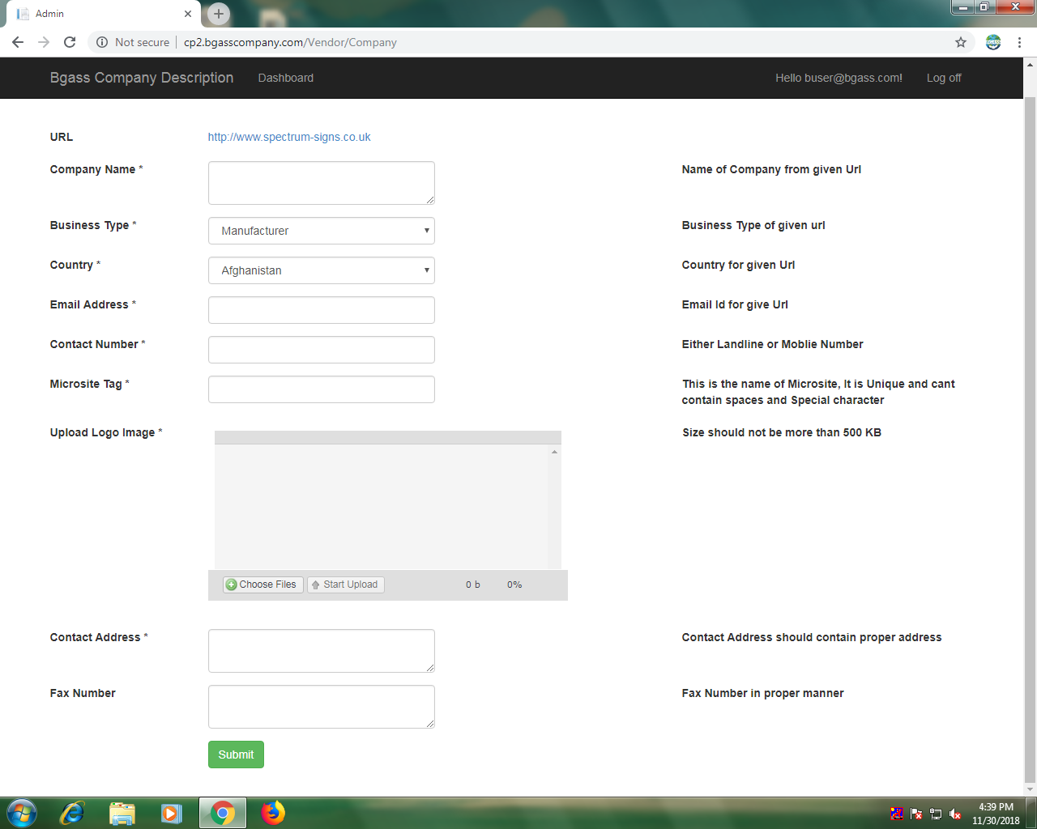
SAMPLE OF COPY PASTE DESCRIPTION

Slide 17
OFFLINE DATA ENTRY PROJECT
A
MEDICAL INSURANCE
B
MORTGAGE
C
RESOURCE MANAGEMENT

Slide 18
RESOURCE MANAGEMENT
1.NATURE OF JOB | RESOURCE MANAGEMENT
2.WORK TYPE | SIMPLIFIED DATA ENTRY(NO CALCULATIONS) TYPING
3.SOTWARE | PROVIDED
4.PAYMENT SECURITY | PDC /BANK GUARANTEE/LC
5.ELIGIBILITY | COMPANY/FIRM
6.DURATION | 11 MONTHS CONTRACT PERIOD(RENEWAL UPTO 36 MONTHS)
7.TOTAL WORKING DAYS | 26 WORKING DAYS PER MONTH
8.WORK FLOW | MINIMUM 3500 FORMS PER MONTH/PER SEAT

Slide 19
MINIMUM NO. OF SLOT | 5PC’S (1 SLOT)
RATE PER FORM | 35.00 INR PER FORM
NO. OF FIELDS | 46 FIELDS
DATA TRANSFER | CLIENT SERVER/FTP(MONTHLY BASIS)
BILLING CYCLE | MONTHLY
SIGNUP | ONSITE/ONLINE WITH INDIAN END CLIENT
TRAINING | PROVIDED FREE
UPFRONT CHARGES | INR 2.50LAC (1 TIME CHARGE)

Slide 20
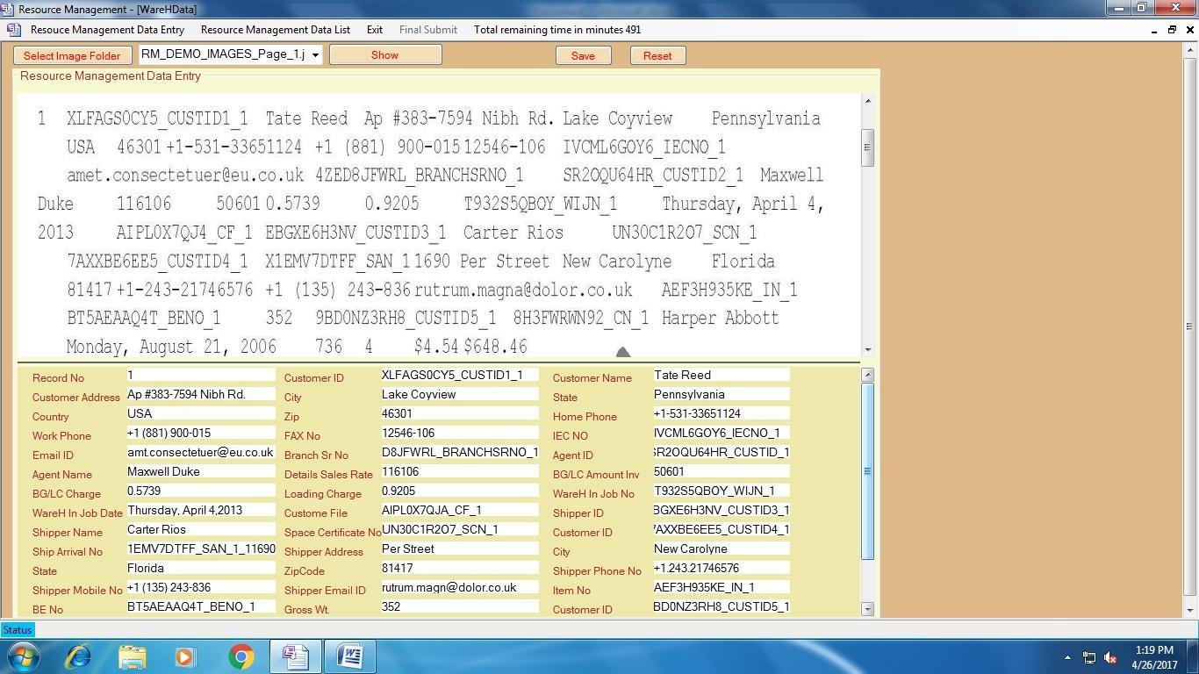
SAMPLE OF RESOURCE MANAGEMENT

Slide 21
MEDICAL INSURANCE
1.NATURE OF JOB | MEDICAL INSURANCE
2.WORK TYPE | SIMPLIFIED DATA ENTRY(NO CALCULATIONS) TYPING
3.SOFTWARE | PROVIDED
4.PAYMENT SECURITY | PDC/BANK GUARANTEE/LC
5.ELIGIBILITY | COMPANY OR FIRM
6.DURATION | 11 MONTH CONTRACT (RENEWAL UPTO 36 MONTHS)
7.TOTAL WORKING DAYS | 26 WORKING DAYS PER MONTH
8.WORK FLOW | MINIMUM 3500 FORMS PER MONTH/PER SEAT

Slide 22
9.MINIMUM NO. OF SLOT | 5 PC’S (1 SLOT)
10.RATE PER FORM | 25.00 INR PER FORM
11.NO.OF FIELDS | 42 FIELDS
12.DATA TRANSFER | CLIENT SERVER/FTP(MONTHLY BASIS)
13.BILLING CYCLE | MONTHLY
14.SIGNUP | ONSITE/ONLINE WITH INDIAN END CLIENT
15.TRAINING | PROVIDED FREE
16.UPFRONT CHARGES | INR 2LAC (1 TIME CHARGE)

Slide 23
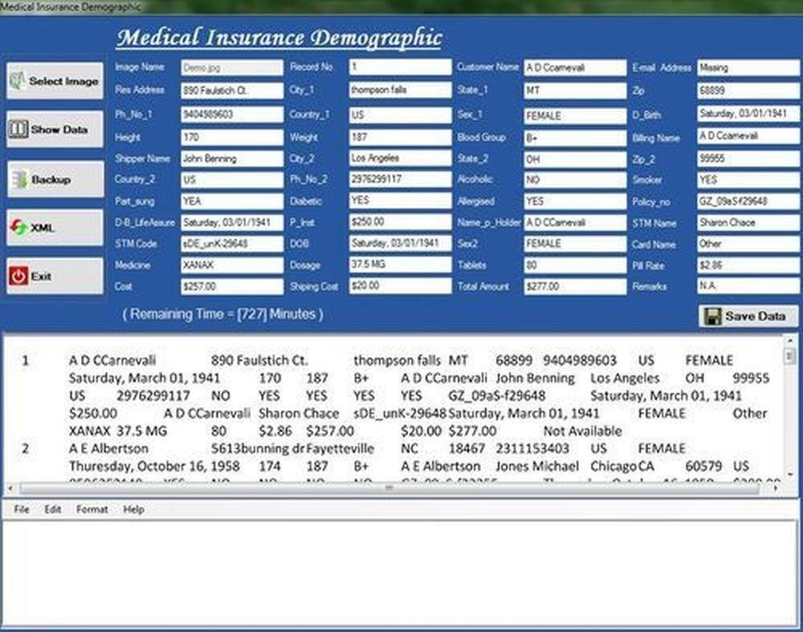
SAMPLE OF MEDICAL INSURANCE

Slide 24
MORTGAGE
1.Nature of job | Mortgage
2.Work type: | Simplified Data Entry (No Calculations)Typing
3.Software: | Provided
4.Payment Security: | PDC / Bank Guarantee/ LC
5.Eligibility: | Company or Firm
6.Duration: | 11 months contract period (renewal up to 36 months)
7.Total Working days: | 26 Working days per month
8.Work Flow: | Minimum 4000 forms per Month/ per seat

Slide 25
1.Minimum no. of slot: | 5 PC’s (1 Slot)
2.Rate per Form: | 22.00 INR. per form
3.No of Fields: | 32 Fields
4.Data Transfer: | Client Server/FTP (Monthly Basis).
5.Billing Cycle: | Monthly
6.Signup: | Onsite/ online with Indian End-Client
7.Upfront Charges: | INR 2 Lac (1 time charge)

Slide 26
PAYMENT SECURITY
POST DATED CHEQUE
11 MONTH LEGAL
AGREEMENT
- BANK GUARANTEE/LETTER OF CREDIT
SERVICES
-Extra software’s for data tracking
-Technical Support
-Provide Hiring records
-Online Onsite training

Slide 27
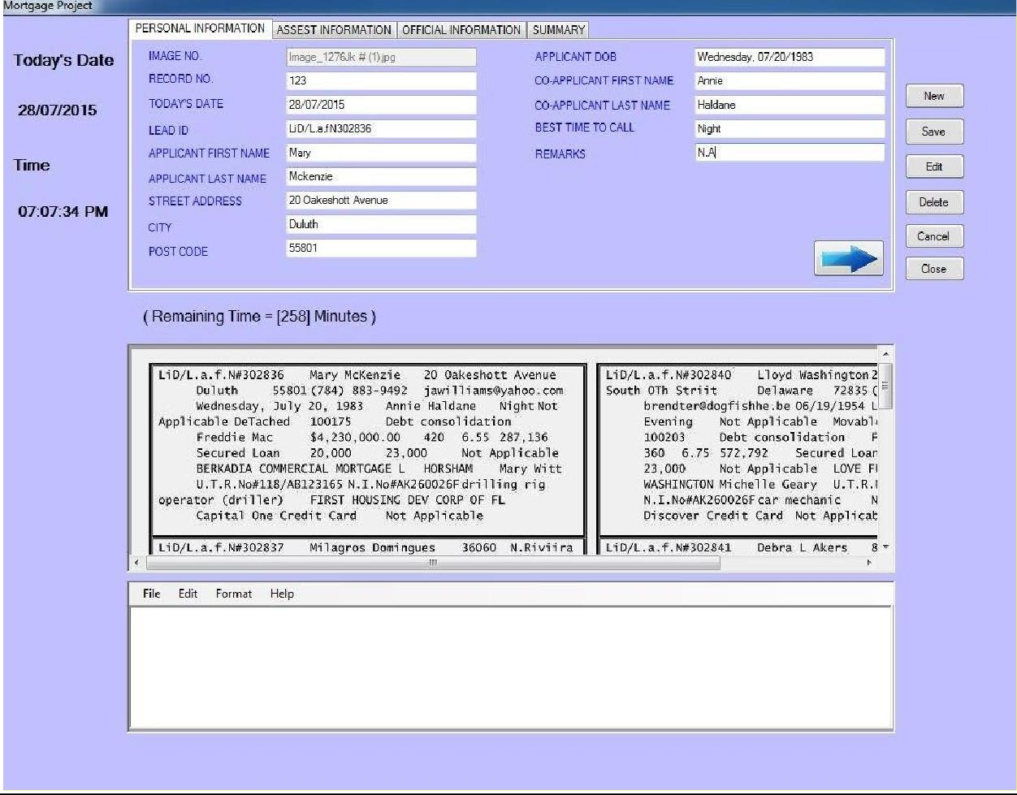
SAMPLE OF MORTGAGE

Slide 28
LEGAL
DOCUMENTS OF OUR COMPANY

Slide 29
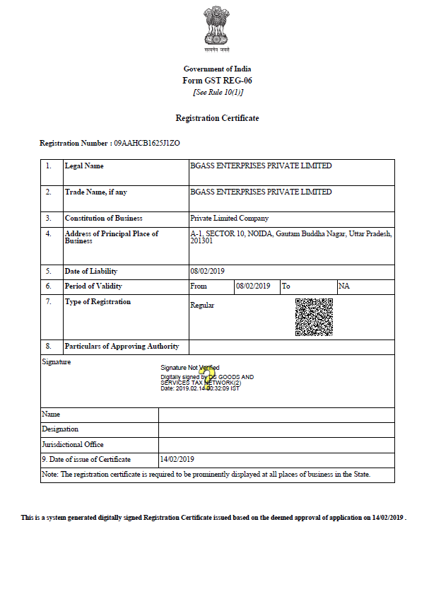

Slide 30
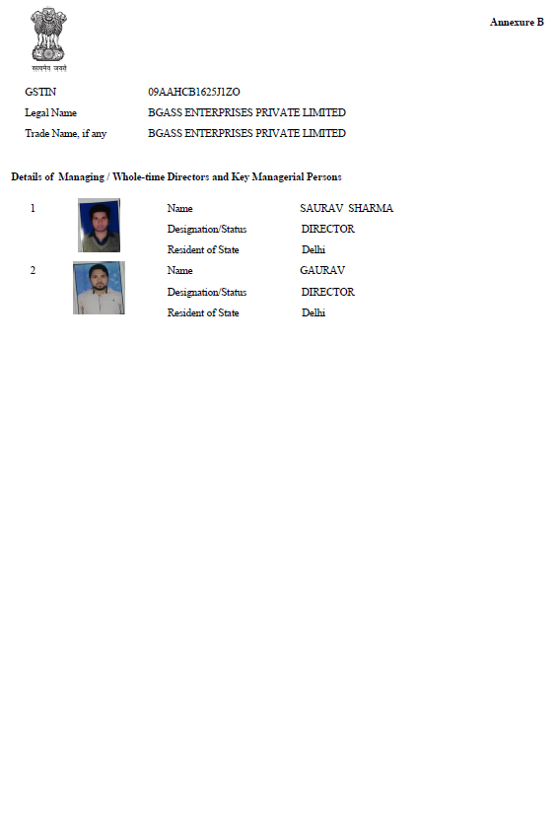

Slide 31
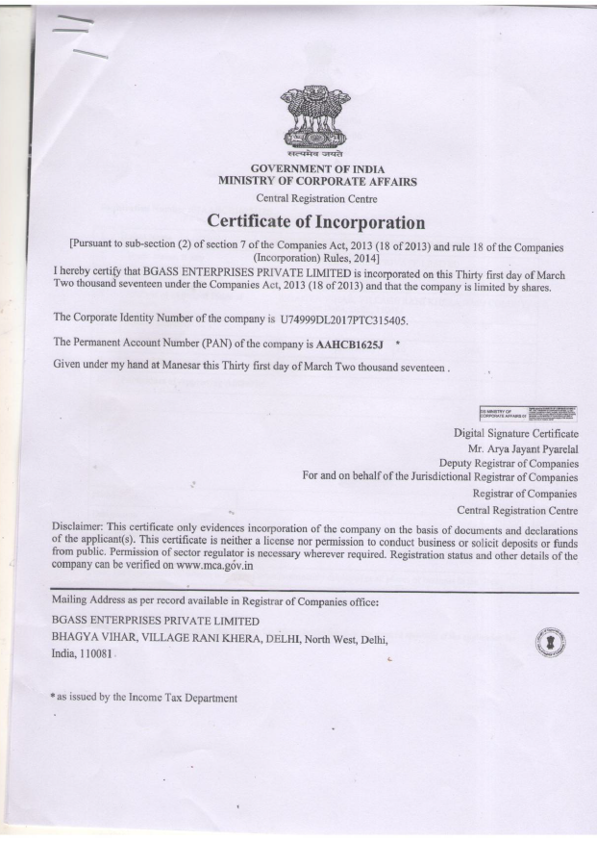

Slide 32
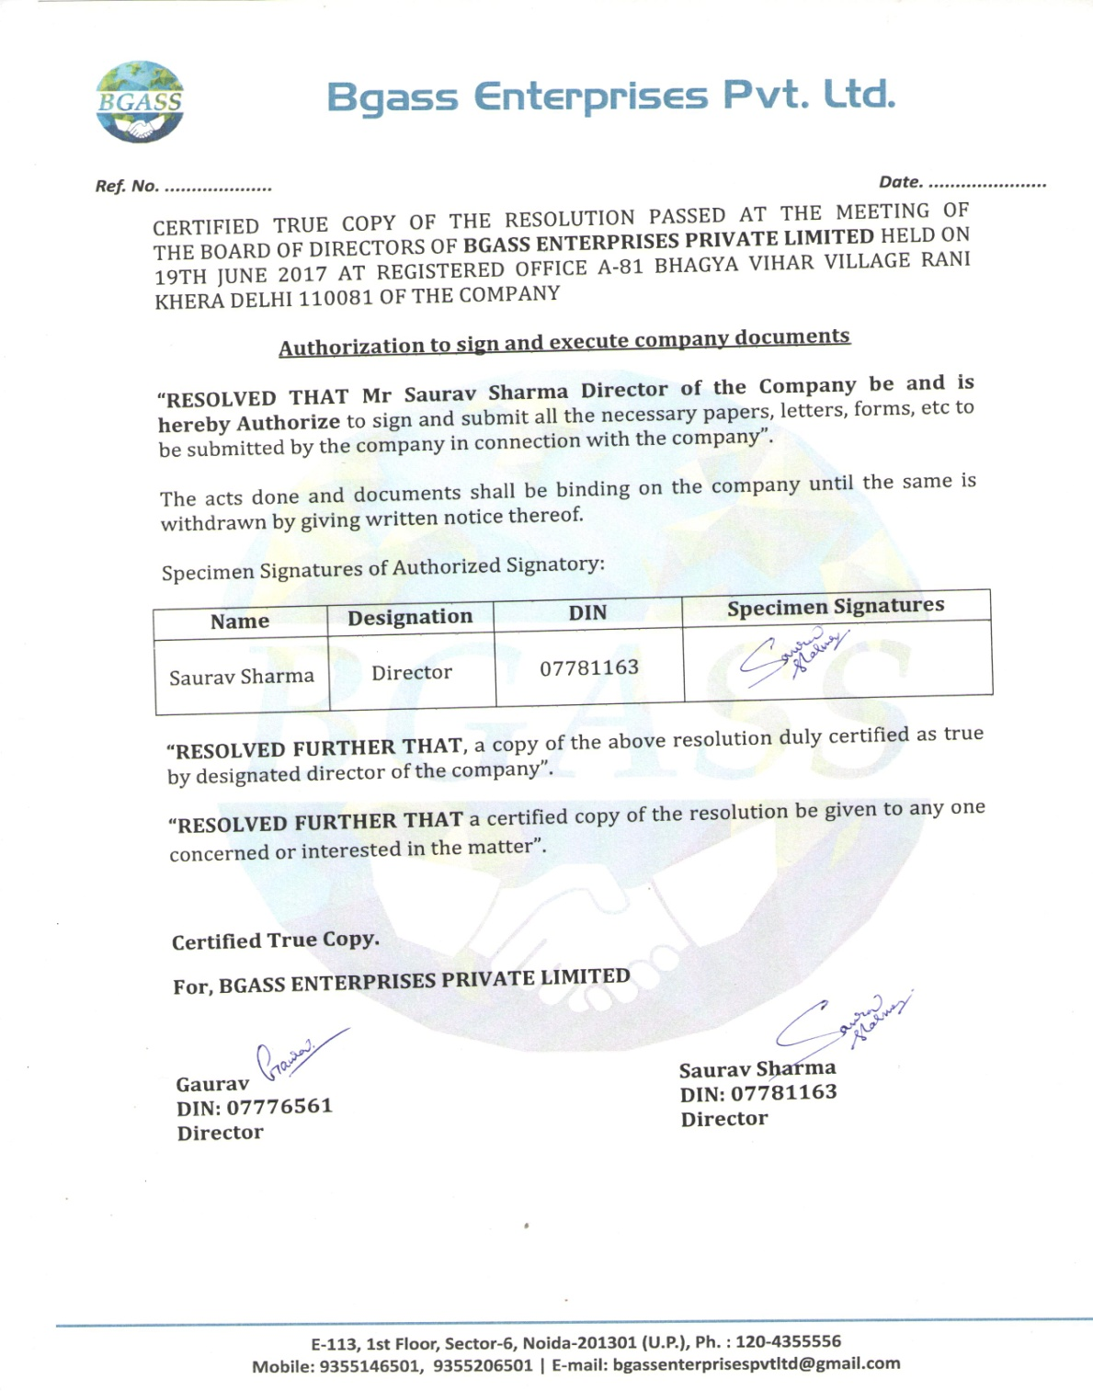

Slide 33
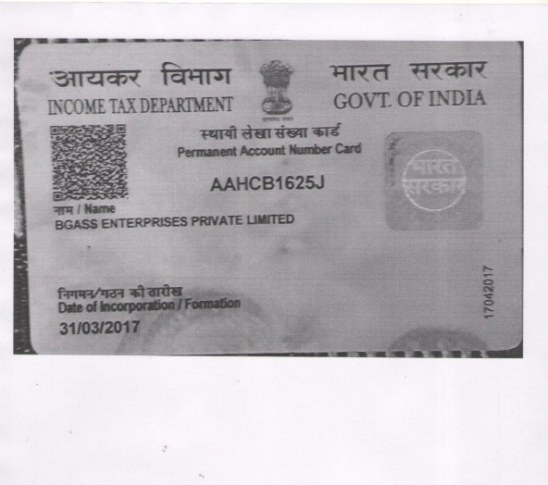

Slide 34
THANKYOU

